Slide 1

Programul Cadru al UE de Cercetare-Inovare
ORIZONT 2020 (2014-2020)
II. POZIȚIA DE LIDER ÎN SECTORUL INDUSTRIAL
1.4. Biotehnologie
III. PROVOCĂRILE SOCIETALE
2. Securitatea alimentară, agricultura durabilă, cercetarea marină şi maritimă şi bioeconomia; schimbări demografice şi bunăstare
Dr. Iulia Iatco
Punctul National de Contact pe KBBE
Tel: +37369943597
E-mail: iulia.iatco@h2020.md

Slide 2
Priorităţile Programului OROZONT-2020 (2014-2020)
Obiectivele si Principiile Comune
I. EXCELENȚĂ ȘTIINȚIFICĂ
1. Cercetările „de frontieră”
2. Tehnologiile viitoare şi
emergente (FET)
3. Acţiunile Marie Curie
4. infrastructurile de cercetare
II. POZIȚIA DE LIDER
ÎN SECTORUL INDUSTRIAL
1.Tehnologiile industriale și
generice:
1.1.TIC,
1.2. Nanotehnologii,
1.3. Materialele avansate,
1.4. Biotehnologie,
1.5. Sistemele avansate de
fabricaţie şi prelucrare
1.6. Spaţiu
2.Acesul la Finantarea de Risc
3. Inovarea in IMM
III. PROVOCĂRILE SOCIETALE
1. Sănătate,
2. Securitatea alimentară, agricultura durabilă,
cercetarea marină şi maritimă şi bioeconomia;
schimbări demografice şi bunăstare;
3. Surse de energie sigure, ecologice şi eficiente
4. Mijloacele de transport inteligente, ecologice
şi integrate;
5. Schimbarile climatice, utilizarea eficientă
a resurselor şi materiile prime;
6.Societăţile favorabile incluziunii,
inovatoare şi sigure.

Slide 3
Prioritatea II.
Pozitia de lider in sectorul industrial
  Developing KBBE requires range of measures
  KBBE needs to:
  1. Be highly integrated to be successful and sustainable
  2. Accelerate the development of basic knowledge and new technologies by intensifying R&D efforts
  3. Encourage & facilitate setting up economic structures supporting cooperation between sectors
  4. Build a underpinning capacity for continued progress by structuring research, innovation, market conditions and education

Slide 4
Provocarile societale. Sectorul agroindustrial.
 | FP7 | HORIZON 2020
Program in total | € 53 bln | € 80 bln
Bioeconomie | € 1,9 bln (1) | € 4,6 bln (2)
+ 50%
+ 140%
(1) Food, Agriculture and Fisheries, and Biotechnology
(2) + Industrial leadership; Marie Curie actions; Risk Sharing Finance Facility; …

Slide 5
2014 BUGET
Sustainable food security – 138 mln euro
Blue growth: unlocking the potential of seas and oceans : 100 mln euro

Slide 6

Boosting cutting-edge biotechnologies as future innovation drivers
• Development of emerging tools (synthetic biology, bioinformatics, systems biology).
• Exploiting the convergence with other enabling technologies such as nanotechnology
(e.g. bionanotechnology) and ICT (e.g. bioelectronics).
• Transfer & implementation into new applications (drug delivery systems, biosensors,
biochips).
Biotechnology-based industrial processes
• Enabling the European industry (e.g. chemical, health, mining, energy, pulp and paper, textile, starch, food processing) to develop new products and processes meeting industrial and societal demands;
• Biotechnology-based alternatives to replace established ones;
• Potential of biotechnology for detecting, monitoring, preventing and removing pollution (enzymatic and metabolic pathways, bio-processes design, advanced fermentation, up- and down-stream processing, dynamics of microbial communities)
• Development of prototypes for assessing the techno-economic feasibility of the developed products and processes.
Innovative and competitive platform technologies
• Develop platform technologies (genomics, meta-genomics, proteomics, molecular tools)
• Development of bio-resources with optimised properties and applications beyond
conventional alternatives;
• Exploration, understanding and exploitation in a sustainable manner of terrestrial and
marine biodiversity for novel applications;
• Biotechnology-based healthcare solutions (diagnostics, biologicals, bio-medical devices).
Biotechnology
Cutting-edge
Biotechnology
Industrial
Biotechnology
Innovative
Technologies

Slide 7
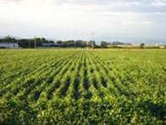
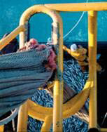
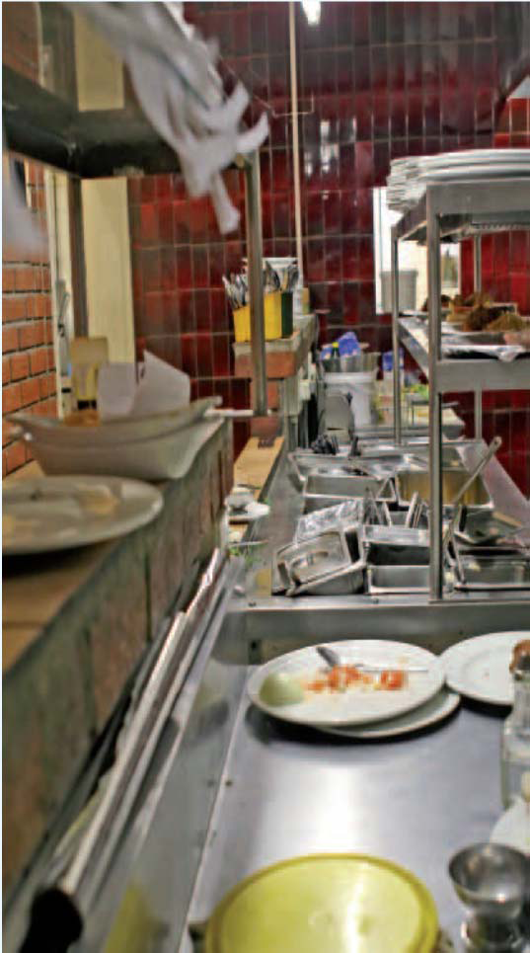

Agricultura si silvicultura
Agricultura si silvicultura
Resursele marine
Produse alimentare
Industrii biologice
Sisteme de productie
Piscicultura
Consumatori
Bioindustrii
Ecosisteme
Cultura acvatica
Nutritie
Purificarea biologica
Silvicultura
Biotehnologii marine
Industria alimentara
Pietile pentru bioproduse

Slide 8
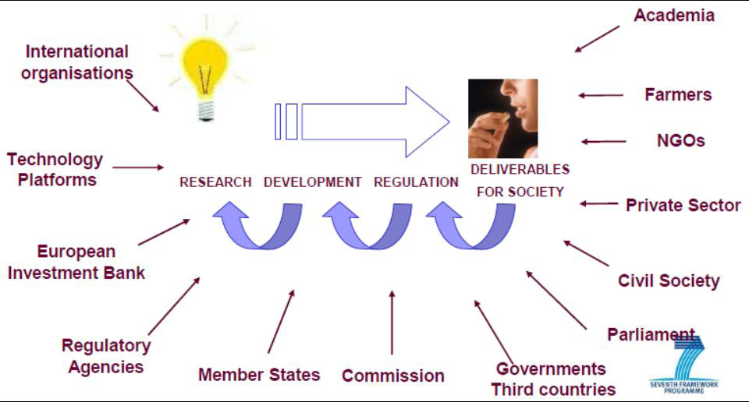
  Succesul depinde de mobilizarea a tuturor actorilor principali.

Slide 9
2014-2015 calls
ec.europa.eu/research/participants/portal
/desktop/en/opportunities/h2020/index.html

Slide 10
Apelurile anuntate
Nr./Code | Apelul Nr. si Denumirea | BUGET | Data Lansarii | Data imita pentru depunere
H2020-SFS-2014-1 | SUSTAINABLE FOOD SECURITY | 1 mln | 11-12-2013 | 26-06-2014
H2020-ISIB-2014-2 | INNOVATIVE, SUSTAINABLE AND INCLUSIVE BIOECONOMY | 16 mln | 11-12-2013 | 12-03-2014 26-06-2014
H2020-ISIB-2014-1 | INNOVATIVE, SUSTAINABLE AND INCLUSIVE BIOECONOMY | 24,5 mln | 11-12-2013 | 26-06-2014
H2020-ISIB-2015-2 | INNOVATIVE, SUSTAINABLE AND INCLUSIVE BIOECONOMY | 17 mln | 11-12-2013 | 24-02-2015 11-06-2015
H2020-ISIB-2015-1 | INNOVATIVE, SUSTAINABLE AND INCLUSIVE BIOECONOMY | 25 mln | 11-12-2013 | 11-06-2015
H2020-LEIT-BIO-2014-1 | BIOTECHNOLOGY | 47,9 mln | 11-12-2013 | 12-03-2014 26-06-2014
H2020-LEIT-BIO-2015-1 | BIOTECHNOLOGY | 29,6 mln | 11-12-2013 | 24-02-2015 11-06-2015

Slide 11
Informaţia utilă
Consultaţii: dupa cerintele
Zilele de informare: 17 ianuarie 2014, Bruxelles, Belgia

Slide 12
Legături utile
12
http://asm.md/
http://cpi.asm.md/
http://fp7.asm.md/
http://h2020.asm.md/
http://ec.europa.eu/research/participants/portal/page/home
http://ec.europa.eu/research/horizon2020/

